Slide 1



Network Engineer in 2024: the age of
Extinction. Adjust or be Jobless.
@CiscoDevNet
#DevNet

Slide 2



Topics to Cover
The Network Engineer Evolves
• The Network Engineer of Old
• The Four Ages of
Networking
rtr$ conf t
• Enter NetDevOps
• Today’s Network Engineer
© 2017 Cisco and/or its affiliates. All rights reserved. Cisco Confidential
© 2017 Cisco and/or its affiliates. All rights reserved. Cisco Confidential

Slide 3

Ye ole Network Engineer
DEVNET-1725
3
© 2017 Cisco and/or its affiliates. All rights reserved. Cisco Confidential

Slide 4

Meet Carl the Network Engineer
Programming Skills
Networking Skills
• TCL
• EEM
• Expect Scripts
• Spanning
-
Tree
• Routing Protocols
• QoS
• VPN Design
• Spanning-Tree
• VOIP
• Fibre Channel
• Security Policy
• MPLS
• Spanning-Tree
• Did I mention Spanning-Tree?
© 2017 Cisco and/or its affiliates. All rights reserved. Cisco Confidential

Slide 5
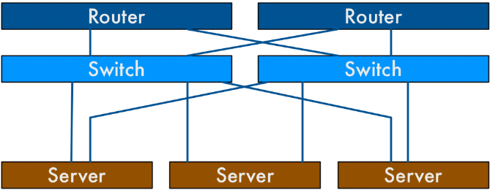
The Network…
© 2017 Cisco and/or its affiliates. All rights reserved. Cisco Confidential

Slide 6
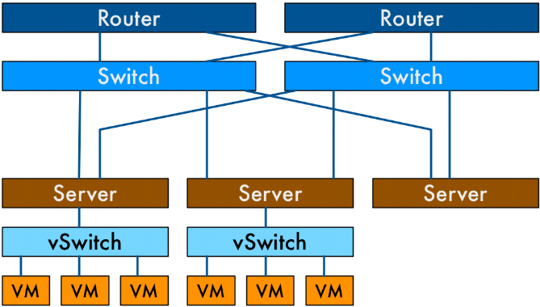
The Network…
© 2017 Cisco and/or its affiliates. All rights reserved. Cisco Confidential

Slide 7
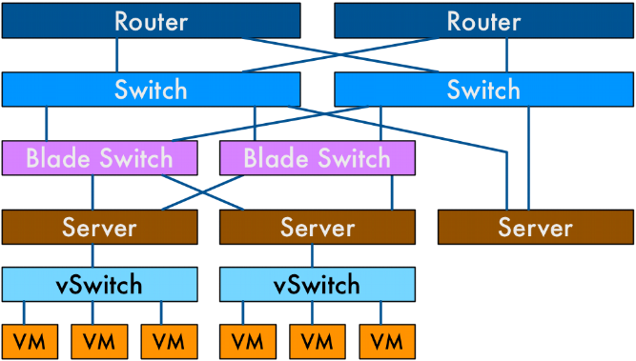
The Network…
© 2017 Cisco and/or its affiliates. All rights reserved. Cisco Confidential

Slide 8
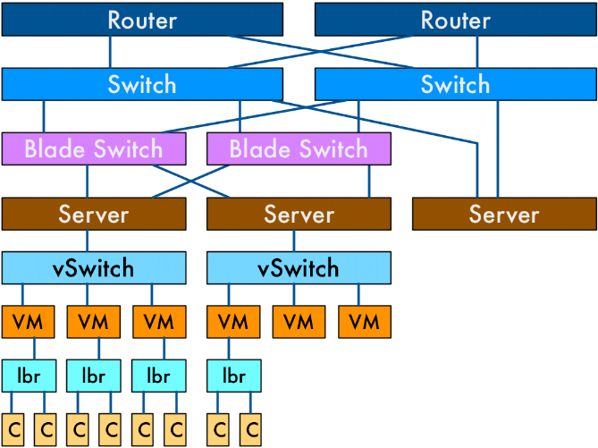
The Network…
© 2017 Cisco and/or its affiliates. All rights reserved. Cisco Confidential

Slide 9
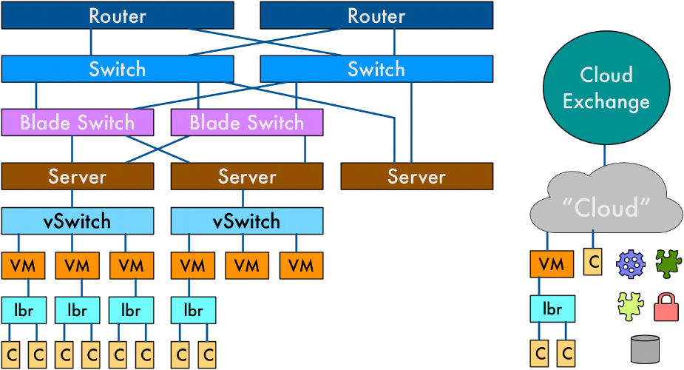
The Network…
© 2017 Cisco and/or its affiliates. All rights reserved. Cisco Confidential

Slide 10
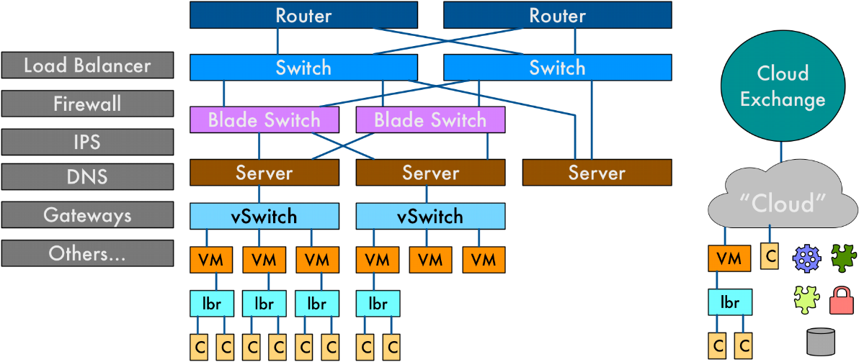
The Network…
© 2017 Cisco and/or its affiliates. All rights reserved. Cisco Confidential

Slide 11
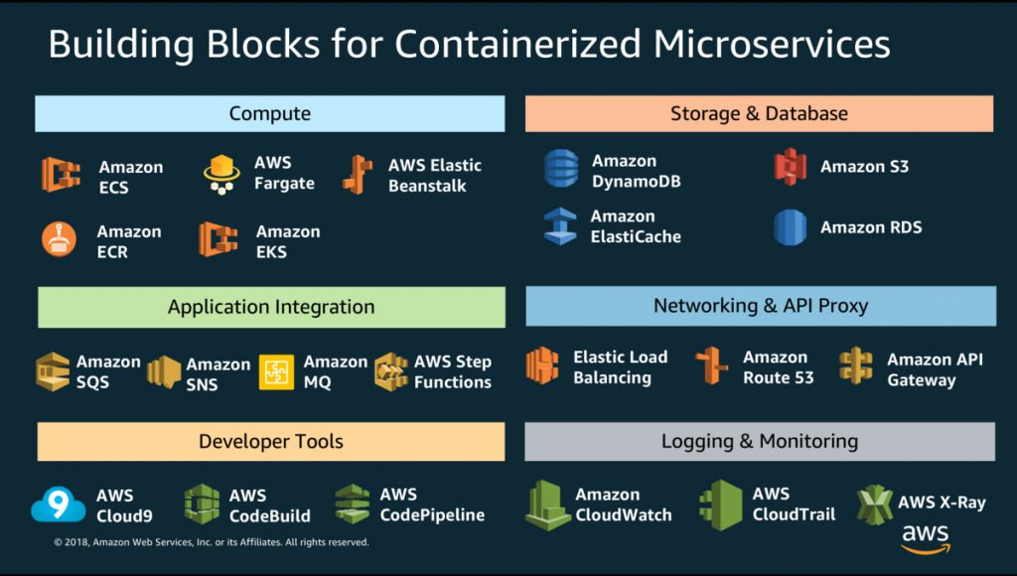

Slide 12
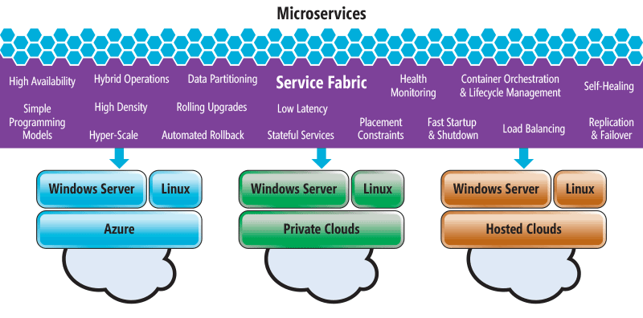

Slide 13
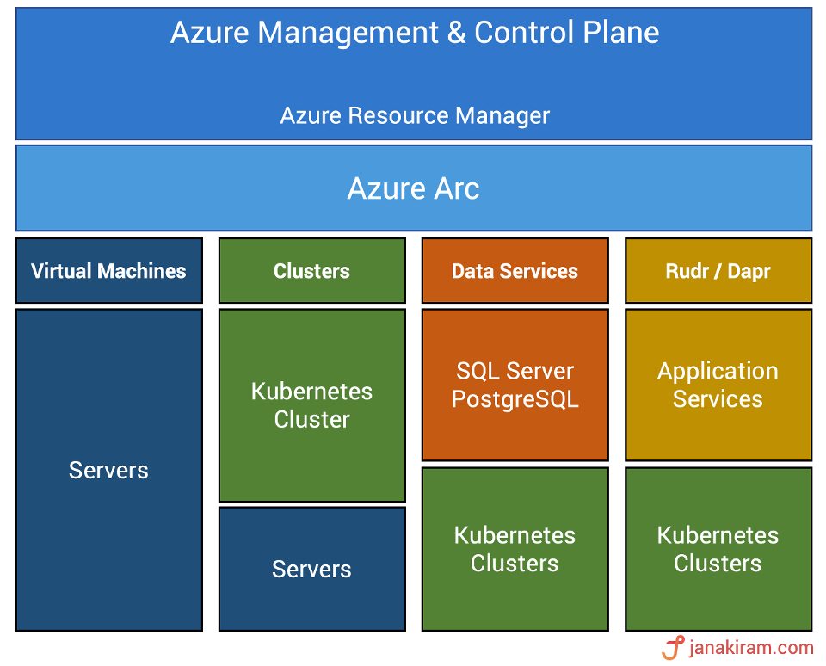

Slide 14



The OSI Model of Networking…
L7: Application
Please don’t ask
about this…
L6: Presentation
L5: Session
L4: Transport
Oh Yeah… We Got
this
L3: Network
L2: Data Link
Black Magic
L1: Physical
© 2017 Cisco and/or its affiliates. All rights reserved. Cisco Confidential

Slide 15

Networking through the ages…
© 2017 Cisco and/or its affiliates. All rights reserved. Cisco Confidential

Slide 16

Stone Age
Spanning Tree
VLANs
The Four Ages of Networking…..
© 2017 Cisco and/or its affiliates. All rights reserved. Cisco Confidential

Slide 17

Stone Age
Bronze Age
Spanning Tree
Routing Protocols
VLANs
WAN Design
IP-magedon
The Four Ages of Networking…..
© 2017 Cisco and/or its affiliates. All rights reserved. Cisco Confidential

Slide 18

Stone Age
Bronze Age
The Renaissance
Spanning Tree
Routing Protocols
SDN
VLANs
WAN Design
OpenFlow
IP-magedon
Controllers
Overlays
MP-BGP
VXLAN
Micro-Segmentation
White Box
The Four Ages of Networking…..
© 2017 Cisco and/or its affiliates. All rights reserved. Cisco Confidential

Slide 19

Stone Age
Bronze Age
The Renaissance
Programmable Age
Spanning Tree
Routing Protocols
SDN
Cloud
VLANs
WAN Design
OpenFlow
Python
IP-magedon
Controllers
REST
/
APIs
Overlays
NETCONF / YANG
MP-BGP
“Fabrics”
VXLAN
Network Function
Virtualization (NFV)
Micro-Segmentation
White Box
Containers
DevOps
NetDevOps!
The Four Ages of Networking…..
© 2017 Cisco and/or its affiliates. All rights reserved. Cisco Confidential

Slide 20

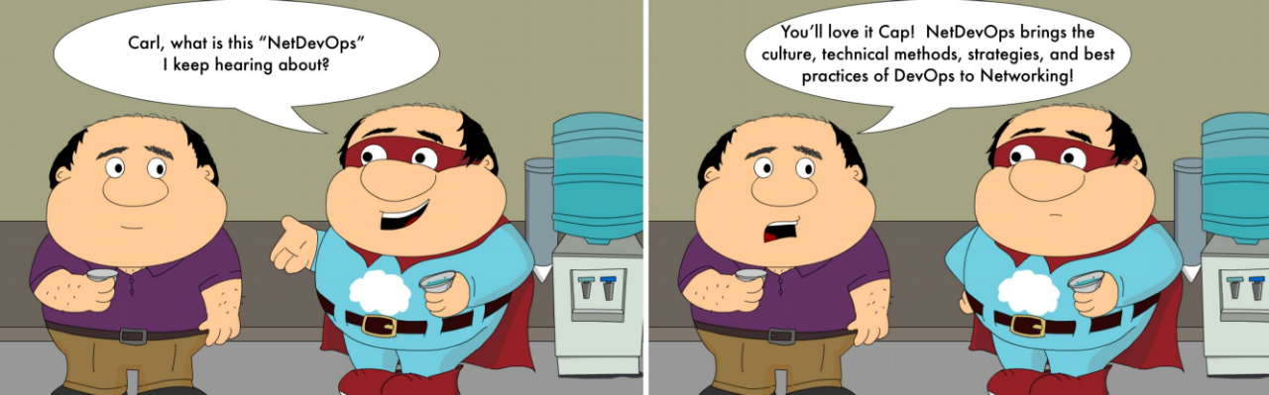
Enter NetDevOps!
(where might this lead…)
© 2017 Cisco and/or its affiliates. All rights reserved. Cisco Confidential

Slide 21
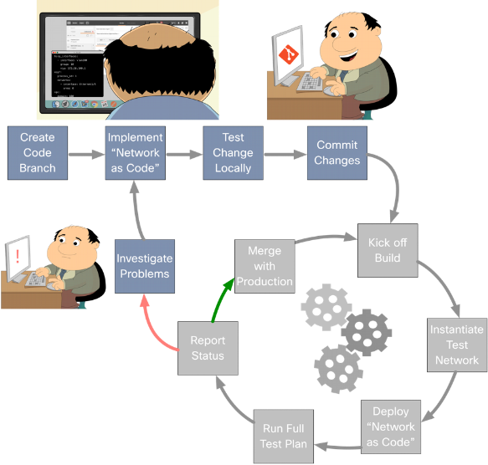
Network Configuration Pipelines
CICD for the Network
© 2017 Cisco and/or its affiliates. All rights reserved. Cisco Confidential

Slide 22
The NetDevOps Engineers Tool Chest
Source Control
Continuous Integration
Artifact Repository
Network Service and Configuration Management
Network Verification
Network Device Interfaces
Network Controllers
Network Virtualization / Simulation Platforms
Security Services
Infrastructure Services
Telemetry & Monitoring
© 2017 Cisco and/or its affiliates. All rights reserved. Cisco Confidential

Slide 23
The NetDevOps Engineers Tool Chest
Source Control
Continuous Integration
Artifact Repository
Network Service and Configuration Management
Network Verification
Enable programmatic interaction for configuration and telemetry
operations through transport protocols and data models.
Network Controllers
Network Device Interfaces
CLI
SNMP
NETCONF
RESTCONF
Network Virtualization / Simulation Platforms
REST
gRPC
JSON
-
RPC
YANG
Network Device Interfaces
Infrastructure Services
Telemetry & Monitoring
Security Services
© 2017 Cisco and/or its affiliates. All rights reserved. Cisco Confidential

Slide 24





The NetDevOps Engineers Tool Chest
Source Control
Continuous Integration
Artifact Repository
Network Service and Configuration Management
Network Verification
Network Controllers provide an abstraction layer to simplify device
management.
Network Device Interfaces
Network Controllers
Network Virtualization / Simulation Platforms
Infrastructure Services
Network Controllers
Security Services
Telemetry & Monitoring
© 2017 Cisco and/or its affiliates. All rights reserved. Cisco Confidential

Slide 25







The NetDevOps Engineers Tool Chest
Source Control
Continuous Integration
Artifact Repository
Network Service and Configuration Management tools enable Network as Code and ensure the
desired state of the network.
Network Service and Configuration Management
Network Verification
Network Device Interfaces
Network Controllers
Network Service and Configuration Management
Network Virtualization / Simulation Platforms
Security Services
Infrastructure Services
Telemetry & Monitoring
© 2017 Cisco and/or its affiliates. All rights reserved. Cisco Confidential

Slide 26
The NetDevOps Engineers Tool Chest
Source Control
Continuous Integration
Artifact Repository
Network Service and Configuration Management
Network Verification
Network Device Interfaces
Network Controllers
Network Virtualization / Simulation Platforms
Security Services
Infrastructure Services
Telemetry & Monitoring
© 2017 Cisco and/or its affiliates. All rights reserved. Cisco Confidential

Slide 27





The NetDevOps Engineers Tool Chest
Source Control systems enable easy management of documents, code, and other pieces of information with tooling to support collaboration, revision
management, and easy distribution.
Source Control
Build Server
Artifact Repository
Continuous Integration
Source Control
Network Verification
Network Device Interfaces
Network Controllers
Network Virtualization / Simulation Platforms
Security Services
Infrastructure Services
Telemetry & Monitoring
© 2017 Cisco and/or its affiliates. All rights reserved. Cisco Confidential

Slide 28





The NetDevOps Engineers Tool Chest
Source Control
CI Servers monitor source control and automate the process of deploying, testing, and other actions
as updates are made.
Artifact Repository
Build Server
Network Service and Configuration Management
Network Verification
Continuous Integration
Network Controllers
Network Device Interfaces
Network Virtualization / Simulation Platforms
Security Services
Infrastructure Services
Telemetry & Monitoring
© 2017 Cisco and/or its affiliates. All rights reserved. Cisco Confidential

Slide 29



The NetDevOps Engineers Tool Chest
Source Control
Store and serve objects.
Continuous Integration
Artifact Repository
Eg Objects: Templates, Containers, Binaries
Eg Protocols: http, scp, ftp, etc
Network Service and Configuration Management
Network Verification
Artifact Repository
Network Device Interfaces
Network Controllers
Network Virtualization / Simulation Platforms
Security Services
Infrastructure Services
Telemetry & Monitoring
© 2017 Cisco and/or its affiliates. All rights reserved. Cisco Confidential

Slide 30




The NetDevOps Engineers Tool Chest
Source Control
Continuous Integration
Artifact Repository
Network Service and Configuration Management
Assure network health through the evaluation of
configuration and operational state.
Network Verification
Network Device Interfaces
Network Controllers
Network Virtualization / Simulation Platforms
Network Verification
Security Services
Infrastructure Services
Telemetry & Monitoring
© 2017 Cisco and/or its affiliates. All rights reserved. Cisco Confidential

Slide 31





The NetDevOps Engineers Tool Chest
Source Control
Continuous Integration
Artifact Repository
Network Service and Configuration Management
Network Verification
Network Device Interfaces
Network Controllers
Network Virtualization and Simulation Platforms support creating and managing network topologies for use across development, test, and production
environments.
Network Virtualization / Simulation Platforms
Security Services
Infrastructure Services
Telemetry & Monitoring
Network Virtualization / Simulation Platforms
© 2017 Cisco and/or its affiliates. All rights reserved. Cisco Confidential

Slide 32


The NetDevOps Engineers Tool Chest
Source Control
Continuous Integration
Artifact Repository
Network Service and Configuration Management
Network Verification
Network Device Interfaces
Network Controllers
Network Virtualization / Simulation Platforms
Support RBAC, AAA, & Certificate Services across
network.
Infrastructure Services
Telemetry & Monitoring
Security Services
Security Services
© 2017 Cisco and/or its affiliates. All rights reserved. Cisco Confidential

Slide 33




The NetDevOps Engineers Tool Chest
Source Control
Continuous Integration
Artifact Repository
Network Service and Configuration Management
Network Verification
Network Device Interfaces
Network Controllers
Network Virtualization / Simulation Platforms
Deliver required services to the network.
Security Services
Infrastructure Services
Telemetry & Monitoring
Eg Services: IPAM, DHCP, DNS, NTP
© 2017 Cisco and/or its affiliates. All rights reserved. Cisco Confidential
Infrastructure Services

Slide 34



The NetDevOps Engineers Tool Chest
Source Control
Continuous Integration
Artifact Repository
Network Service and Configuration Management
Network Verification
Network Device Interfaces
Network Controllers
Network Virtualization / Simulation Platforms
Infrastructure Services
Ingest, process, & make available telemetry data
from the network.
Security Services
Telemetry & Monitoring
Eg Sources: syslog, netflow, gRPC, SNMP
© 2017 Cisco and/or its affiliates. All rights reserved. Cisco Confidential
Telemetry & Monitoring

Slide 35

© 2017 Cisco and/or its affiliates. All rights reserved. Cisco Confidential

Slide 36

© 2017 Cisco and/or its affiliates. All rights reserved. Cisco Confidential

Slide 37

DEVNET-1725
34
Today’s Network
Engineer
© 2017 Cisco and/or its affiliates. All rights reserved. Cisco Confidential

Slide 38
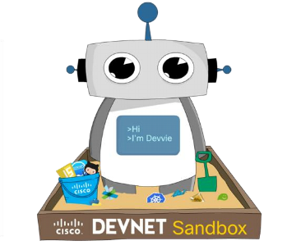

Carl’s 3 Step Approach to Network
Programmability
Phase 1
Phase 2
Phase 3
• Python
• REST APIs
• Linux Networking
• Container Networking
• Network Function
Virtualization
• Linux Skills
• Config Management
• JSON/XML/YAML • Docker
• git/GitHub
• NETCONF/YANG
As Needed
• Network Controllers
• IOT Networking
• Cloud Networking
• ”DevOps”
DEVNET-1725
35
© 2017 Cisco and/or its affiliates. All rights reserved. Cisco Confidential

Slide 39

Carl has Embraced Programmability!
Network Skills
Platform Skills
• Layer 2 & 3 Fundamentals
• Linux Administration
• Quality of Service
• Container Fundamentals
• Security and Segmentation
• Micro Service Platforms
• Linux Networking
• Cloud Fundamentals
• Container Networking
Programming Skills
• Cloud Networking
• Data Formats (ex: JSON, YAML, etc)
• IOT Networking
• Python and APIs
• Model Driven Programmability
(ex: REST, NETCONF, etc)
• Source Control (ex: git, GitLab, etc)
• Network Function Virtualization
• Configuration Management
(ex: NSO, Ansible, Puppet, etc)
© 2017 Cisco and/or its affiliates. All rights reserved. Cisco Confidential
DEVNET-1725
© 2018 Cisco and/or its affiliates. All rights reserved. Cisco Public
36

Slide 40

© 2017 Cisco and/or its affiliates. All rights reserved. Cisco Confidential

Slide 41
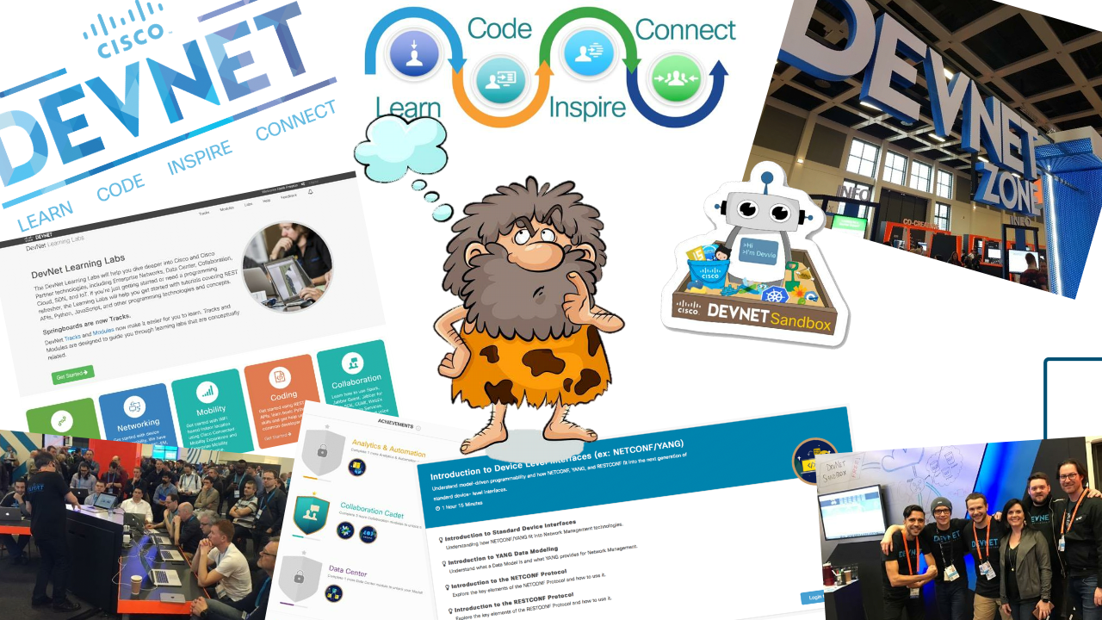
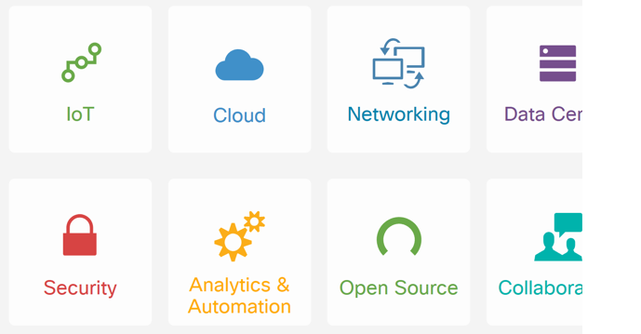

© 2017 Cisco and/or its affiliates. All rights reserved. Cisco Confidential

Slide 42
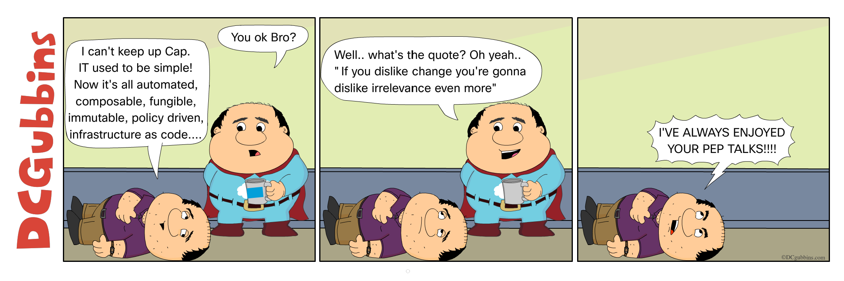
Summing up

Slide 43
Review
• We looked back on the history of the network and network
engineering
• Traveled through the Four Ages of Networking
• Explored how NetDevOps will change Networking
• Considered the skills a network engineer needs today
© 2017 Cisco and/or its affiliates. All rights reserved. Cisco Confidential

Slide 44
What do do next?
• NetDevOps Readings
• NetDevOps Learning Resources
•
Embrace NetDevOps, Say Goodbye to
a "Culture of Fear”
•
Network Programmability Basics Video
Course
•
NetDevOps Goes Beyond
Infrastructure as Code
• NetDevOps Learning Labs
• NetDevOps Live!
• What does "Network as Code" Mean?
• NetDevOps Videos
•
A Network Engineers Journey in
Programmability
•
How to be a Network Engineer in a
Programmable Age
•
NetDevOps and the Rise of the
Programmable Network
• Network as Code in Action
• Benefits of Configuration Management
© 2017 Cisco and/or its affiliates. All rights reserved. Cisco Confidential

Slide 45







Got more questions? Stay in touch!
Hank Preston
developer.cisco.com
hapresto@cisco.com
@CiscoDevNet
@hfpreston
facebook.com
/
ciscodevnet
/
http://github.com/hpreston
http://github.com/CiscoDevNet
© 2017 Cisco and/or its affiliates. All rights reserved. Cisco Confidential

Slide 46



